Slide 1
Total Welfare & Government Intervention
AP Microeconomics * Stater * Unit 2, Day 3

Slide 2
Consumer Surplus
Difference between what a consumer is willing to pay and the price he actually pays
(only happens when the price you pay is LESS than what you were willing & able to pay)
If you were able and willing to pay $20 for a new shirt, and you got it for $16, what is the consumer surplus?
$4

Slide 3
Consumer Surplus
If you and two friends went to the movies expecting to pay $10 for tickets, but only had to pay $8 each, what is the total consumer surplus?
$6

Slide 4
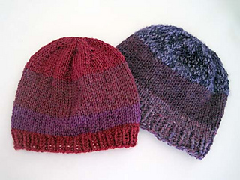
Producer Surplus
Difference between what a producer is willing to sell a product for and the price she actually sells it for
(only happens when the price received is MORE than what they were willing & able to sell that product for)
If you were willing to sell the hat you knitted for $10, but were able to sell it for $13, what is the producer surplus?
$3

Slide 5
Producer Surplus
If you and two friends all baked cookies to sell, and you expect to each sell one dozen for $4, but you each are able to sell a dozen for $7, what is your total producer surplus?
$9

Slide 6
Total Welfare
The sum of consumer and producer surplus.
Also called total benefit or total surplus
NOT the same as the surplus where Qs > Qd

Slide 7
Government Intervention
Consumer and producer surplus can be affected when the government intervenes in the free market.
The government can sometimes set a maximum or minimum price for a given product or service
Called price controls.
Gov’t moves the price away from equilibrium.

Slide 8
Price Floor (graph on board)
When the government sets a minimum price for a given
product or service
Only has an effect when set above the market equilibrium price
Examples: minimum wage laws; agriculture price supports for farmers

Slide 9
Price Ceiling (graph on board)
When the government sets a maximum price for a given product or service
Only has an effect when set below the market equilibrium price
Examples: rent control policies; India’s recent price ceilings on Uber rides

Slide 10
In-class Graphing practice
If you’ve missed class or just need review of the graphing that we practiced for the effects of price floors and ceilings on consumer and producer surplus, be sure to check out these videos:
https://www.youtube.com/watch?v=1EzY4Vl460U
https://www.youtube.com/watch?v=4GVD94OUMwA&list=PL6B2DBE4C2FC8F845&index=12
https://www.youtube.com/watch?v=n0LXkA9kato&index=13&list=PL6B2DBE4C2FC8F845

